Slide 1

What are the drivers of a Country’s happiness?
Arghavan Abtahi - Mariana Brinkley - Rafael Santos
Shayan Beizaee - Sandra Pastrana

Slide 2

Agenda
World Happines Analysis
Hypothesis
Data
Exploration
Analysis
Discussion

Slide 3
Hypothesis
World Happines Analysis
What are the drivers of a countries happiness?
Our Hypothesis is that a country’s happiness is directly correlated to:
The county’s economic indicators. The healthier the economic indicator the happier the happiness index.
Their weather. The warmer the weather, the happier the country.
Their musical expressions. The happier the country, the happier the music of their choice.
Their tourism. The happier the country, the more tourism it will attract.
Their athletes. The happier the country the more Olympic athletes will represent them.
Hypothesis | Data | Exploration | Analysis | Discusion |

Slide 4
Data
World Happines Analysis
Questions we asked:
1. How happy is the world?
Data: World Happiness Report: http://worldhappiness.report/ed/2018/
2. How does happiness correlate with economic indicators:
Data: World Happiness Report: http://worldhappiness.report/ed/2018/
Data: The world bank indicators API http://api.worldbank.org
Hypothesis | Data | Exploration | Analysis | Discusion |

Slide 5
Data
World Happines Analysis
Questions we asked:
3. How does tourism correlate with happiness?
Data:
4. How does happiness correlate with weather:
Data: Open Weather API
Hypothesis | Data | Exploration | Analysis | Discusion |

Slide 6
Data
World Happines Analysis
Questions we asked:
1. How happy is the world?
Data: World Happiness Report: http://worldhappiness.report/ed/2018/
2. How does happiness correlate with economic indicators:
Data: World Happiness Report: http://worldhappiness.report/ed/2018/
Data: The world bank indicators API http://api.worldbank.org
Hypothesis | Data | Exploration | Analysis | Discusion |

Slide 7
Data
World Happines Analysis
Questions we asked:
3. How does tourism correlate with happiness?
Data:
4. How does happiness correlate with weather:
Data: Open Weather API
Hypothesis | Data | Exploration | Analysis | Discusion |

Slide 8
Data
World Happines Analysis
Questions we asked:
5. Is there are relationship between how happy the country and the kind of music they choose to listen and prefere?
Data needed:
Representative sample of top songs per country through out the year.
Characteristics of each song rating: happiness, energy, speachiness and istrumentalness.
Data sources:
Spotify, Spotypy API
Hypothesis | Data | Exploration | Analysis | Discusion |

Slide 9
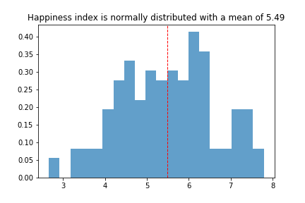
Exploration & Analysis – Happiness Index
World Happines Analysis
Hypothesis | Data | Exploration & analysis | Discusion |

Slide 10
Exploration & Analysis – Wheather
World Happines Analysis
Hypothesis | Data | Exploration & analysis | Discusion |

Slide 11
Exploration & Analysis – Tourism
World Happines Analysis
Hypothesis | Data | Exploration & analysis | Discusion |

Slide 12
Exploration & Analysis - Athletics
World Happines Analysis
Hypothesis | Data | Exploration & analysis | Discusion |

Slide 13
Exploration & Analysis – Economic Indicators
World Happines Analysis
Hypothesis | Data | Exploration & analysis | Discusion |

Slide 14
Exploration & Analysis – Musical expression
World Happines Analysis
Three step process:
Collect the top songs for different countries.
Made a list of countries and dates to search for their top 200 songs. Chose to select one day a month for 66 countries that were available in SpotifyCharts
The Api does not allow for this, so we used some one else’s code. Installed a the code into PythonData
Saved the results into a cvs file
Classify each songs happiness, energy, danceability and speechiness.
Used the spotify API for python called Spotipy. Classified each song collected.
Compare against the World Happiness Index.
Hypothesis | Data | Exploration & analysis | Discussion |

Slide 15
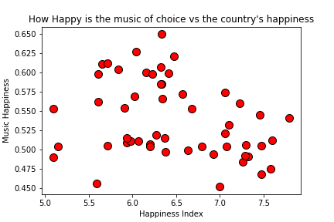
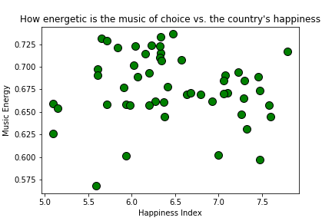
Exploration & Analysis – Musical expression
World Happines Analysis
R sqr= -0.29 P-Value= 0.034
R sqr= -0.07 P-Value= 0.59
Hypothesis | Data | Exploration & analysis | Discussion |

Slide 16
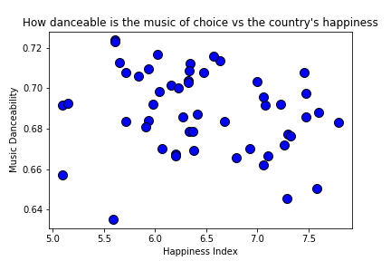
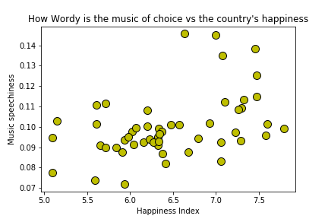
Exploration & Analysis – Musical expression
World Happines Analysis
R sqr= -0.21 P-Value= 0.13
R sqr= 0.42 P-Value= 0.00183
Hypothesis | Data | Exploration & analysis | Discussion |

Slide 17
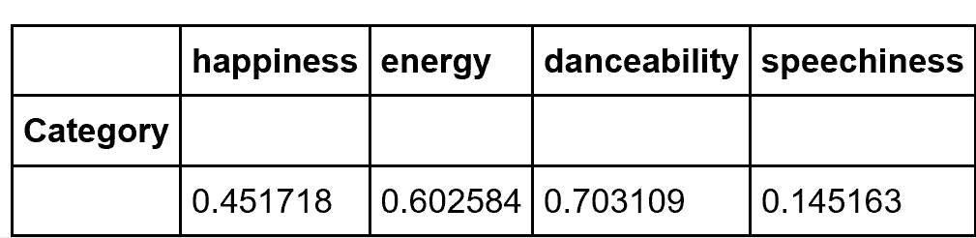
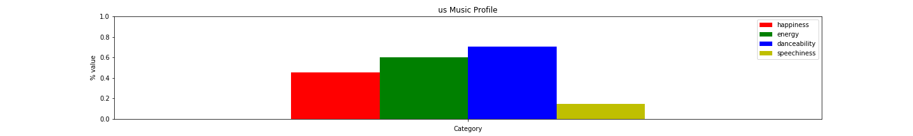
Exploration & Analysis – Musical expression
World Happines Analysis
Side questions: What is the specific music profile of the US? Can we find a song with that specific profile?
Ahora Dice (feat. J Balvin & Arcangel)
https://www.youtube.com/watch?v=c73Cu3TQnlg
Hypothesis | Data | Exploration & analysis | Discussion |

Slide 18
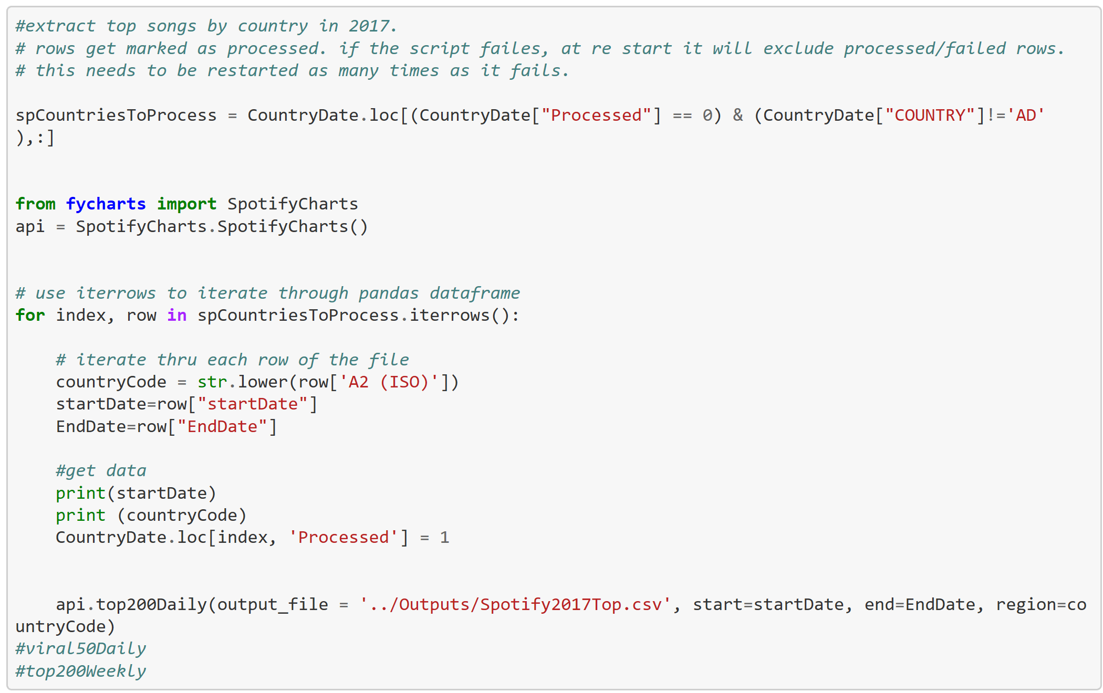
Spotify – Code to get top 200 songs
World Happines Analysis
Looped through a Dataframe with a list of countries and a random day per month, for a total of 12 days per country.
Appendix

Slide 19
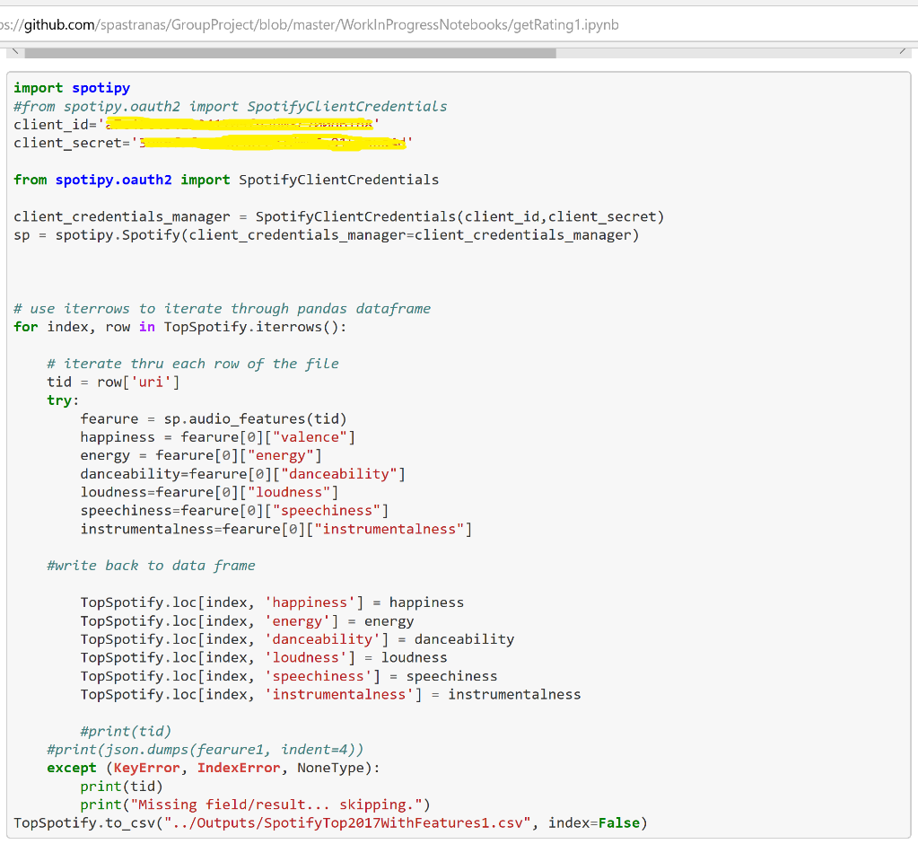
Spotify – Use Spotipy API to classify songs
World Happines Analysis
Looped each song collected. Final count were 66 countries and 60,000 songs.
Appendix

